Slide 1


Green Pace
Security Policy Presentation
Developer: Stephen Mathew
CS 405

Slide 2

OVERVIEW: DEFENSE IN DEPTH
The image below describes Defense in Depth – a multi-layered defense system.

Slide 3
THREATS MATRIX
Likely Threats that have more frequency | Priority Standards have higher relevance
Low priority Standards with lower relevance | Unlikely Threats that have more frequency to occur

Slide 4
10 PRINCIPLES
Validate Input Data
Heed Compiler Warnings
Architect and Design for Security Policies
Keep It Simple
Default Deny
Adhere to the Principle of Least Privilege
Sanitize Data Sent to Other Systems
Practice Defense in Depth
Use Effective Quality Assurance Techniques
Adopt a Secure Coding Standard

Slide 5
CODING STANDARDS
STD – 003: Guarantee that storage for strings has sufficient space for character data and the null terminator
STD – 004: Do not store an already-owned pointer value in an unrelated smart pointer
STD – 005: Properly deallocate dynamically allocated resources
STD – 009: Do not attempt to create a std::string from a null pointer
STD – 010: Do not define a C-style variadic function
STD – 007: Guarantee exception safety
STD – 001: Do not cast to an out-of-range enumeration value
STD – 002: Use valid references, pointers, and iterators to reference elements of a container
STD – 008: Range check element access
STD – 006: Use a static assertion to test the value of a constant expression
Rank from Highest to Lowest LVL According to SEI CERT Standards
Rule | Severity | Likelihood | Remediation Cost | Priority | Level
STD-001-CPP | Medium | Unlikely | Medium | Low | 2
STD-002-CPP | High | Probable | High | Medium | 2
STD-003-CPP | High | Likely | Medium | High | 5
STD-004-CPP | High | Likely | Medium | High | 5
STD-005-CPP | High | Likely | Medium | High | 5
STD-006-CPP | Low | Unlikely | High | Low | 1
STD-007-CPP | High | Likely | High | Medium | 3
STD-008-CPP | High | Unlikely | Medium | Medium | 2
STD-009-CPP | High | Likely | Medium | High | 5
STD-010-CPP | High | Probable | Medium | High | 4

Slide 6
ENCRYPTION POLICIES
Flight - An encryption at flight is when data is encrypted while being transmitted. The data may not be encrypted while its being stored and/or being used, but the data will become encrypted as its being transferred to another storage location. This encryption protects sensitive data of an entity even if the data is intercepted by an outside source because the data will also be encrypted without the proper key. These encryptions are helpful when employees and/or users are allowed to telecommute or mobile work from the office.
At Rest - An encryption in rest is when data is encrypted while it is being stored. The data is accessible, but the encryption prevents the data from being readable without a proper key. This encryption allows a company and/or government to stay protected and have additional defenses against any in-person crimes such as theft of device or thumb drives with sensitive data on it.
In Use - An encryption in use is when data is encrypted while being used and gives certain users certain access to the data depending on an employee’s security level. This encryption protects the business or government’s databases by creating layers of security to separate user activity from employees. These encryptions prevent new or lower security level employees from gaining total access to the data in the system.

Slide 7
TRIPLE-A POLICIES
Authentication - Authentication uses User Logins, passcodes, possible secure networks, and other security features such as fingerprint scanning and two-feature identification depending on the security level for certain users.
Authorization - Authorization uses the authentication features to identify the level of security access given to a certain user. The security level allows the user to have admin credentials in order to gain access to databases, files, and employee records. An admin user can make changes to databases and files. Also, admin users also are given the ability to add new users to have access to certain files in the system.
Accounting - Accounting uses the features from authentication and authorization to keep records on when data has been changed in a system and who made these changes. There are also certain systems that require a user to make a comment explaining why a user made certain changes to a system. These comments are created for both security reasons and future assistance. These defenses work together in order to give a system a multi-layer defense by the features relying on each other.

Slide 8
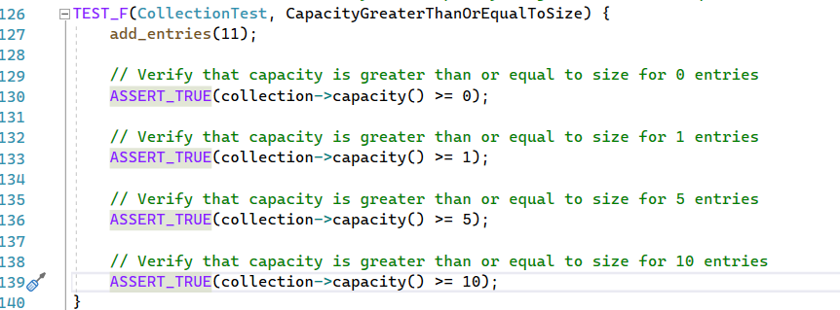
Unit Testing #1 – Is capacity greater than or equal to size for entries?
[

Slide 9
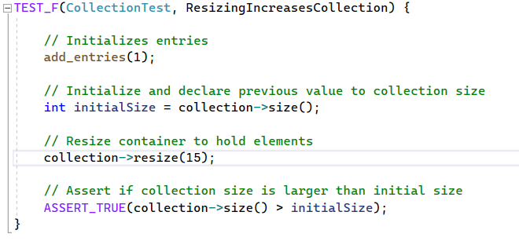
Unit Testing #2 – Does resizing increase collection?

Slide 10
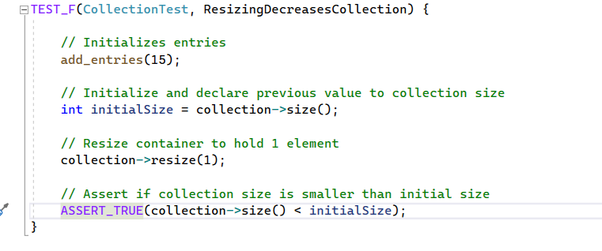
Unit Testing #3: Does resizing decrease collection?

Slide 11
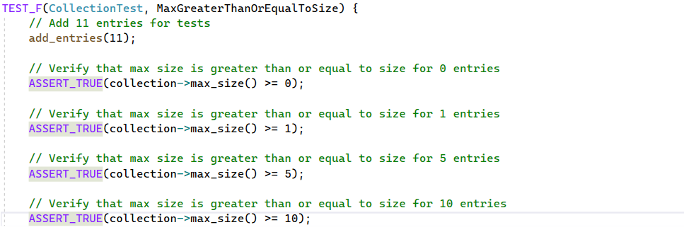
Unit Testing #4: Is max size greater than or equal for entries?

Slide 12

AUTOMATION SUMMARY

Slide 13
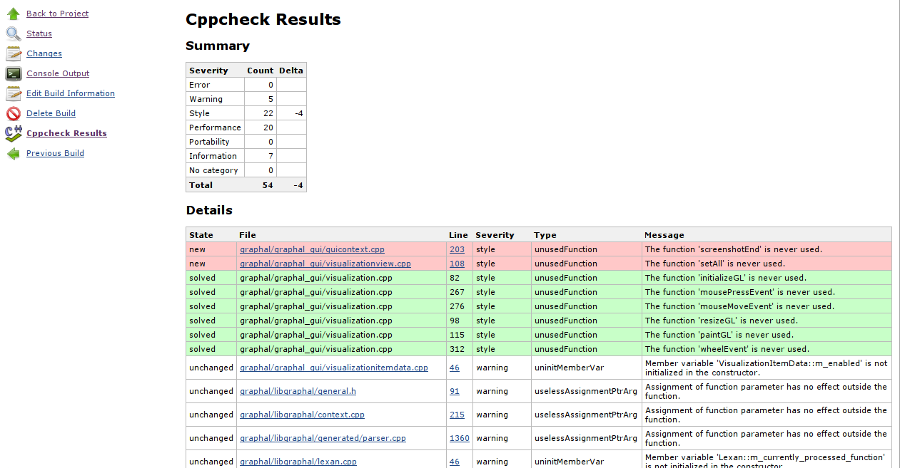
TOOLS
DevSecOps pipeline - DevSecOps is integrating security into your software development life cycle. The software development life cycle is the cycle from the creation of code to its testing to its push into the main branch
Tools – External tools such as cppcheck and IDEs testing are used to discover warnings, errors, and messages when developed code is being executed. From google, here is an example of the cppcheck tool warnings and messages.

Slide 14
RISKS AND BENEFITS
Developing security now -
Risks – Extended project time length due to multiple tests being conducted on sections of code prior to the sections being pushed into the main project.
Benefits – A more secure project, the entire project’s code is developed and consistent with the consideration of security policies and practices, and security warnings can be discovered during the development phase cycle of the project.
Wait to develop security -
Risks – Certain parts of the code aren’t compatible with security features, unsecure code during development, total cost goes overbudget due to implementing security features and completing the project the due date.
Benefits – Faster code development phase cycle.

Slide 15
RECOMMENDATIONS
Security development during life cycle
Developers
Triple A
Encryption types

Slide 16
CONCLUSIONS
Security standards and practices are important for protecting digital assets, especially as we move into new places like the metaverse. These measures are needed not just for businesses and governments, but also for everyday people. In this space, data will be presented in new forms. While no security system is completely hacker-free, developers can help keep systems up to date by continually protecting against hackers.

Slide 17
REFERENCES
Cppcheck plugin. Jenkins. (2019, August 27). https://wiki.jenkins-ci.org/display/JENKINS/Cppcheck-Plugin.html
Joint task force. (2020, September). Security and Privacy Controlsfor Information Systems and Organizations. https://nvlpubs.nist.gov/nistpubs/SpecialPublications/NIST.SP.800-53r5.pdf
Sei External Wiki Home. SEI External Wiki Home - Homepage - Confluence. (2023b, September 8). https://wiki.sei.cmu.edu/confluence/

